Slide 1

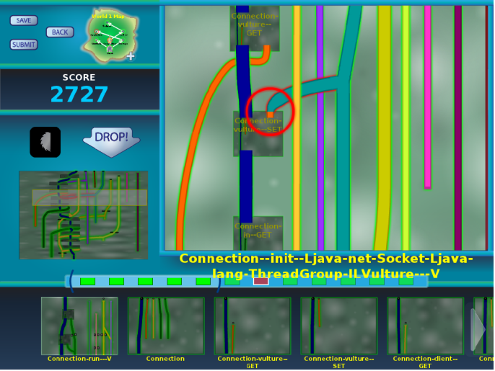
All work and no play makes software engineering dull
Michael D. Ernst
University of Washington
Future of Software Engineering Symposium
July 17, 2013
Notes:
My goal is to raise issues, not to present completed work.
Our community has a lot of work to do.
Ask questions!

Slide 2
Hard problems in software engineering
Choosing modularity and abstractions
Task breakdown
Dividing tasks between people and tools
Transparent vs. powerful tools
Optimizing intractable problems
Cooperation, competition, and specialization
What is the role of training?
Information overload
Making SE fun
Notes:
SE has been wildly successful, and will continue to be. I want to talk about some remaining problems.
* what sort and how?
* what are people good at. What about after training?
: big-picture view vs. focused tasks
: focus on problem, not program

Slide 3
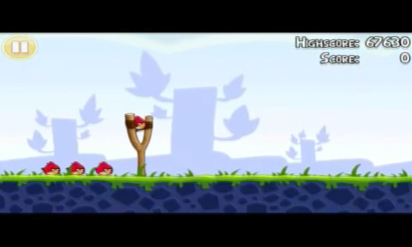
Angry Birds

Slide 4
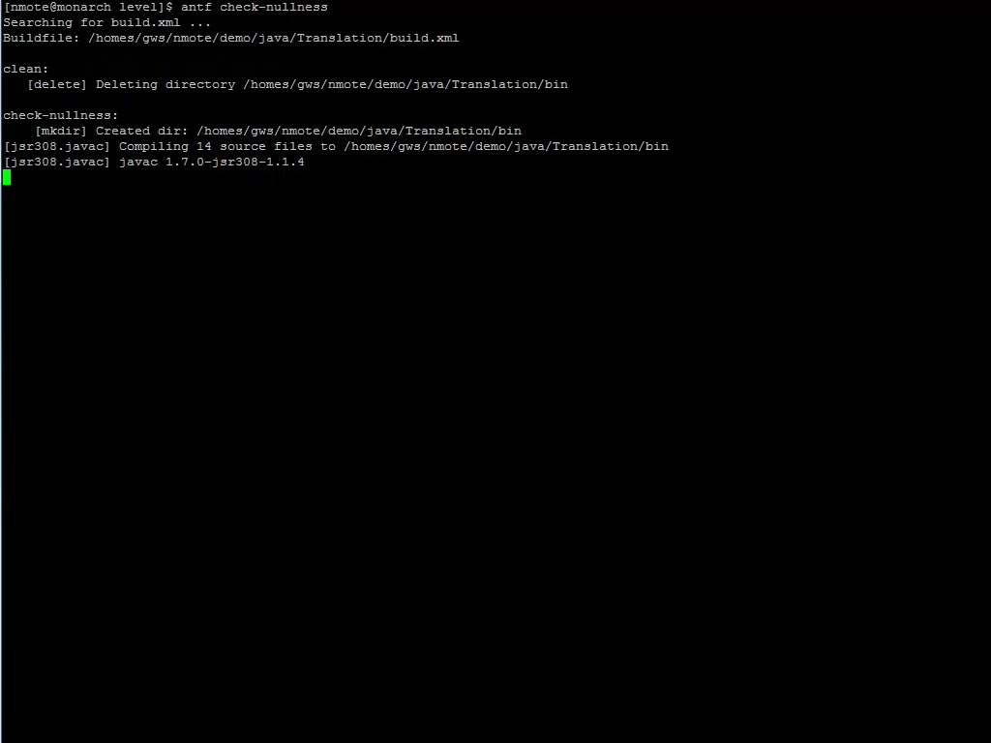
Software verification

Slide 5
Which is more fun?
Play games
Prove your program correct

Slide 6


Crowd-sourced software verification
Goal: Verify software while you wait for the bus
Make software verification easy and fun
Make the game accessible to everyone
Harness the power of the crowd

Slide 7
Programming is like a game
Fun puzzles that compel me to solve them:
minimize a test case
fix a bug
create a feature
refactor
When is it not fun?
What is usability in SE?
Notes:
We can learn from games.
A sense of progress and accomplishment
I love my work and I'm happy that I get paid to do it.

Slide 8
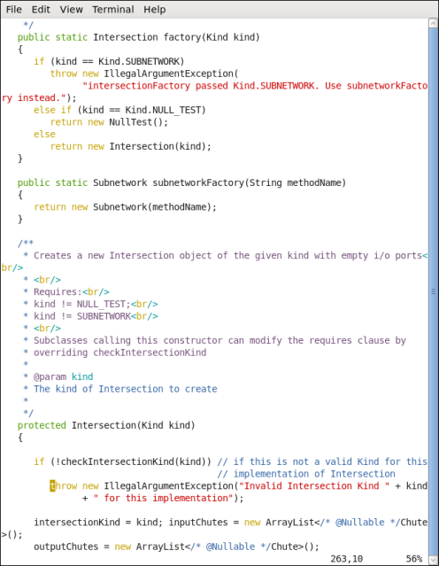
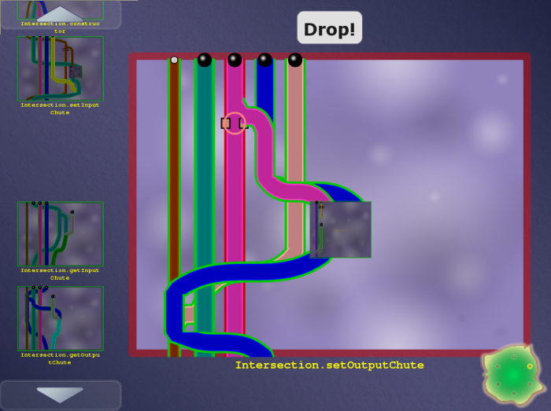
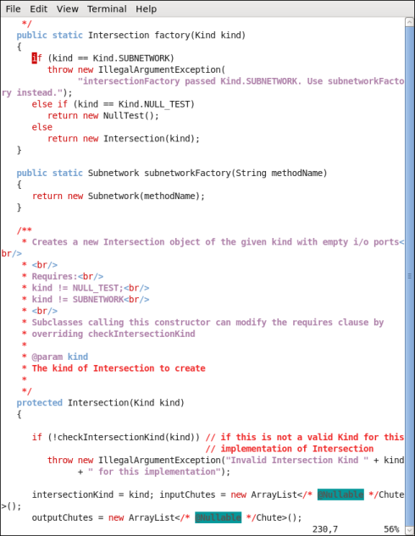
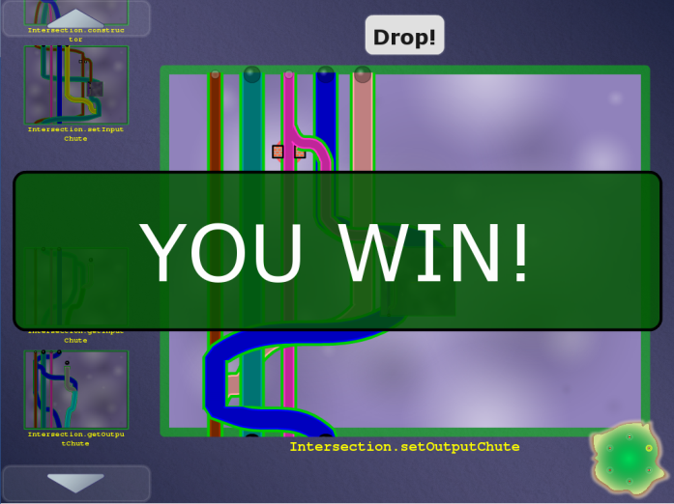

Code
Game
Automatic translation
Encodes a constraint system
Encodes a constraint system
Free labor
Highly-skilled, expensive labor
Verified software
(with proof/ annotations)
Completed game
Automatic translation

Slide 9
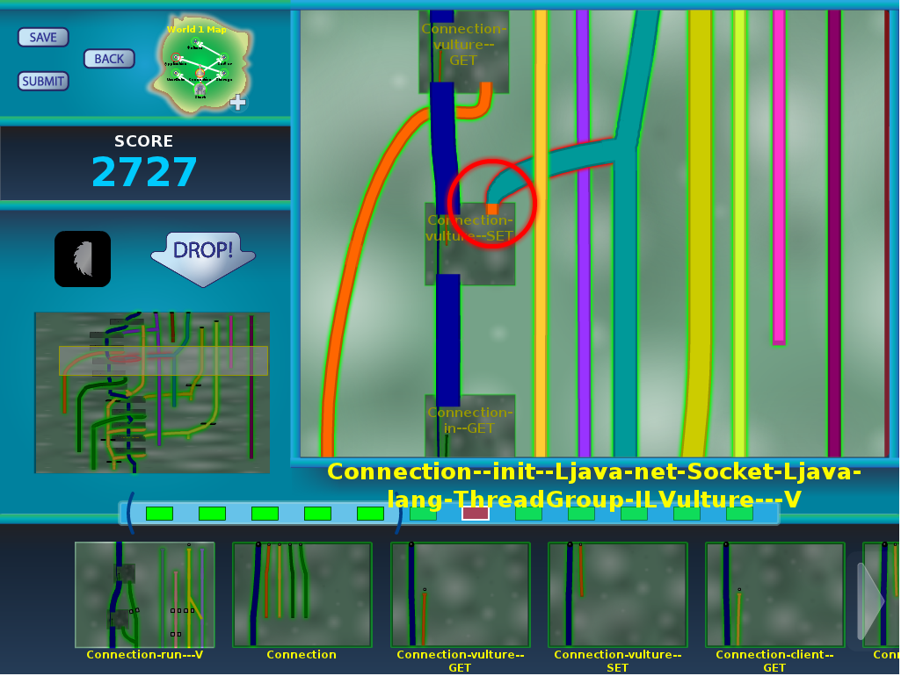
Pipe Jam game demo
Notes:
In the order: wind, earth, crash.

Slide 10
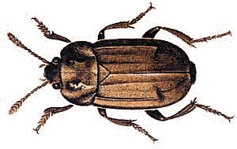
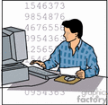
Code
Game
Automatic translation
Free labor
Highly-skilled, expensive labor
Bug detected, notify programmer
Completed game
with buzzsaws
Automatic translation

Slide 11
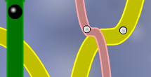
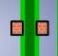
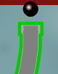
Program ↔ game correspondence
Intuition: dataflow
Pipe ↔ a variable
Pipe width ↔ a property of the variable (type)
Ball ↔ a value
Ball size ↔ a property of the value
Pinch point ↔ requirement
Unmodifiable pipe/ball ↔ requirement

Slide 12
Example: encryption
Goal: no cleartext is sent over the network
Pipe ↔ a variable
Pipe width ↔ narrow: encrypted, wide: cleartext
Ball ↔ a value
Ball size ↔ small: encrypted, large: cleartext
Pinch point ↔ network communication
Unmodifiable pipe/ball ↔ cleartext from user

Slide 13
Example: null pointer errors
Goal: no dereference of null
Pipe ↔ a variable
Pipe width ↔ narrow: non-null, wide: maybe null
Ball ↔ a value
Ball size ↔ small: non-null, large: null
Pinch point ↔ dereference
Unmodifiable pipe/ball ↔ literal null

Slide 14
Type flow vs. dataflow
Multiple flows per variable
A variable’s type may have multiple qualifiers
@Immutable Map<@English String, @NonNegative Integer>
Some variables are not represented at all
primitives (int, …) when analyzing null pointer errors
No loops
If program is verifiable, solvable in polynomial time
Human leverage: high-level pattern matching
More accurate intuition: type constraints
Solving a game = type inference

Slide 15
Other examples
SQL injection
unintended side effects
format string and regexp validation
incorrect equality checks
race conditions and deadlocks
units of measurement
aliasing
27 of the CWE/SANS Top 41 Most Dangerous Software Errors
…

Slide 16
What verification challenges?
Type system approach
Modular; local reasoning & understanding
Equally powerful as any other verification technology (theorem proving, model checking, …)
Less effective for correctness of numerical computations
Not good for full functional correctness
Not good for temporal properties (focus on data)

Slide 17
Challenges
Yes!
Can we build the system?
End-to-end: game ↔ program verification
Will the game be fun?
Better than waiting for the bus
Do people outperform verification algorithms?
Inference is undecidable (human experts ≫ algorithms)
Hypothesis: no for correct, verifiable programs,
yes for incorrect or unverifiable programs
Location of buzzsaws is key to the whole approach
Game players only have to reduce overall verification cost, not fully verify the program
Also see FoldIt (protein folding)
Maybe

Slide 18
Scoring
Score is influenced by:
Collisions (verifiability)
Use of buzzsaws (trusted assumptions)
Pipe widths, distinguishing input and output pipes (re-usability of modules)
Multiple solutions may be possible
Score is a proxy for quality of verification result
Have we just rephrased the hardest question?
Heuristics & search strategies for an optimization problem
Discover algorithms that may outperform players

Slide 19
Collaboration and competition
High-score boards
Collaborative teams solve challenges
Share scripts
Interaction: chats, forums, …

Slide 20
3-way collaboration: machines, players, verification experts
Machines: Automatic inference and optimizations
Brute force is not feasible for large programs
Error messages from type inference systems are poor
Players do work that automated tools cannot
Leave a few easy challenges to encourage players
Verification experts do work that players cannot
Classify un-verifiable code as safe or insecure

Slide 21
Optimization
Simplify the challenge to its essence
Related to the program/problem duality in SE
In Pipe Jam:
Remove multiple pinch points in a row
Remove pipes that suffer no conflicts
Set pipes to known values, forbid changes to them

Slide 22
Avoiding the big picture
Novice users accomplished more when given less information but offered guidance
[“Reducing the barriers to writing verified specifications”
by Schiller & Ernst, OOPSLA 2012]

Slide 23
Elide irrelevant information
Example: primitives, when proving lack of null pointer errors
Also loses documentation, program context!
Leave in some easy challenges so players feel good about progress

Slide 24

Information overload & relevance
Too much detail: player/user gets distracted
Too little detail: unable to produce useful result
Example: optimization
Example: hiding details

Slide 25
Utilizing a community
What is the best way to utilize a community?
Redundancy
Reconfigure games to adjust difficulty
A potentially rich resource
Angry Birds: 5 million hours of play time per day
200,000 years spent (as of 2011)
How do gaming and developer communities differ?

Slide 26
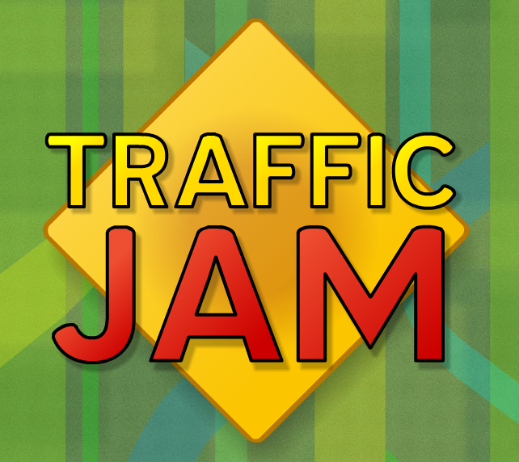
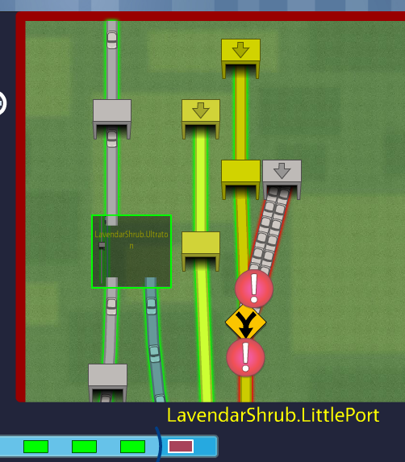
Demo: Traffic Jam

Slide 27
Problem decomposition
Program design methodologies:
Procedural
Object-oriented
Functional
Logic programming
Design patterns
Tradeoffs among competing desiderata
A game design makes similar choices

Slide 28
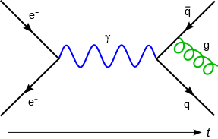
Problem: action at a distance
Pipe colors indicate non-local dependences: uses of the same variable must be consistent

Slide 29
Organizing a program’s constraints
Use programmer-supplied decomposition
Classes, methods
Programmer probably had a good reason
Variables, calls cross-cut these structures
No one presentation is best for all tasks
Another decompositions are possible
Bring together variables, move apart other issues
Notes:
Other decompositions are possible
There is still action at a distance, but it’s caused by long lines

Slide 30
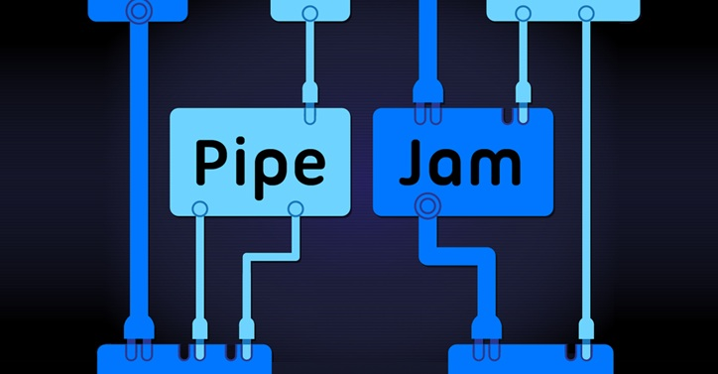
Demo: Grid World

Slide 31
New skin for the game
Pipes ⇒ boxes
One box for arbitrarily many pipes of the same color
Pipe connections ⇒ lines
Didn’t eliminate action at a distance, but made it explicit
Identical constraints and XML input file
Player is solving the same problem, but it feels like a different game
Will it be more successful?

Slide 32
The game is harder than it looks
Example: prove that myMap.get(someKey) returns a non-null value (recall: Map.get returns null if the key isn’t in the map)
myMap is declared as Map<KeyType, @NonNull valueType>
someKey is a key in myMap
Example: handle polymorphism (Java generics)
The problem is fundamentally difficult

Slide 33
Designing a (SE) game
Goals:
Address a hard problem
Use human skills
Fun
A challenging task with no simple rules
Modularity and abstraction make it even harder

Slide 34
Designing a program analysis
(Examples: model checking, abstract interpretation)
Key problem: the abstraction
Capture the essence of the problem
Too much detail: infeasible analysis
Too little detail: does not prove desired properties
Designer insight and iteration are crucial
Each new successful abstraction is a breakthrough

Slide 35
Designing a machine learner
Key issues:
Learning algorithm (SVM, decision trees, neural network, genetic algorithm, …)
Feature space (problem representation): the information fed to the algorithm
State of the art:
Try lots of algorithms
Try lots of feature spaces
When one works, publish it

Slide 36
Designing a (SE) game
Goals:
Address a hard problem
Use human skills
Fun
A challenging task with no simple rules
Modularity and abstraction make it even harder

Slide 37

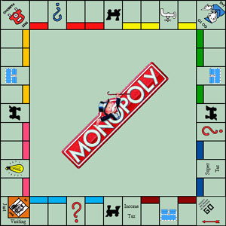

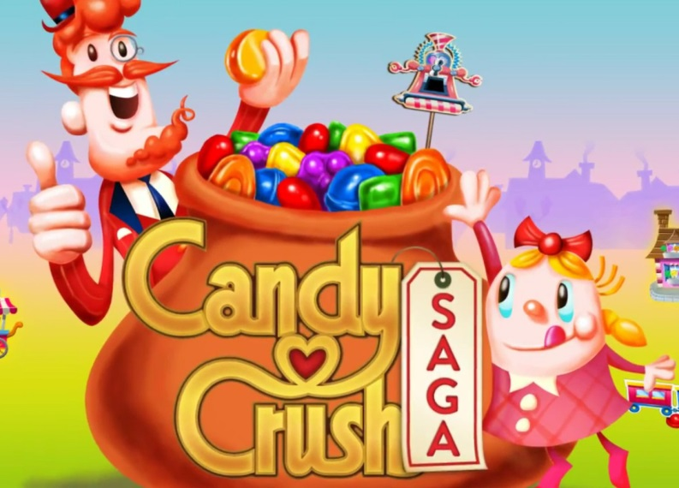
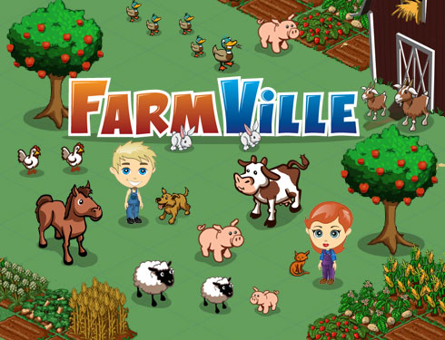
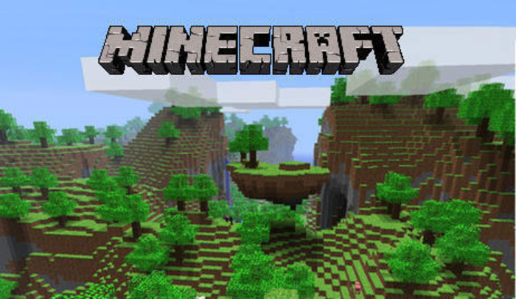
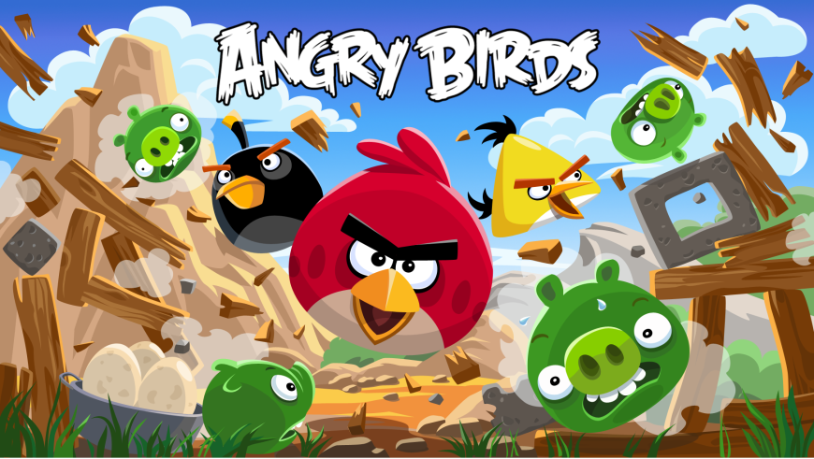
Some successful games

Slide 38
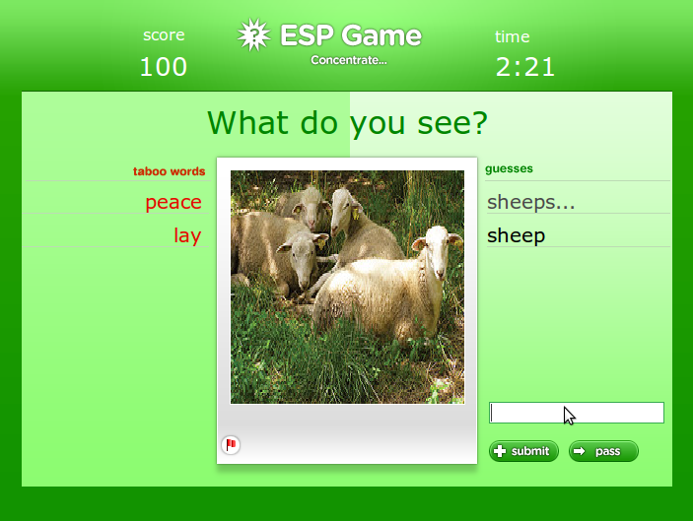
ESP game (image labeling)

Slide 39
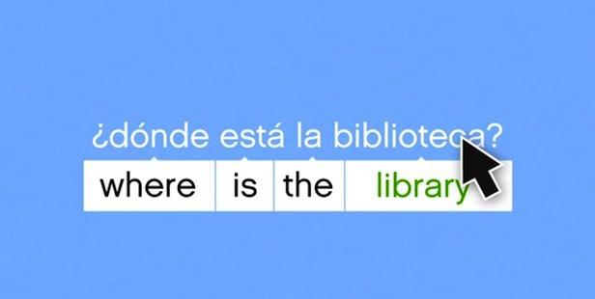
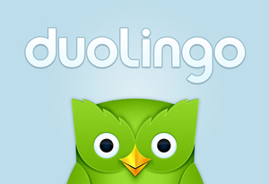
Duolingo (translation)

Slide 40
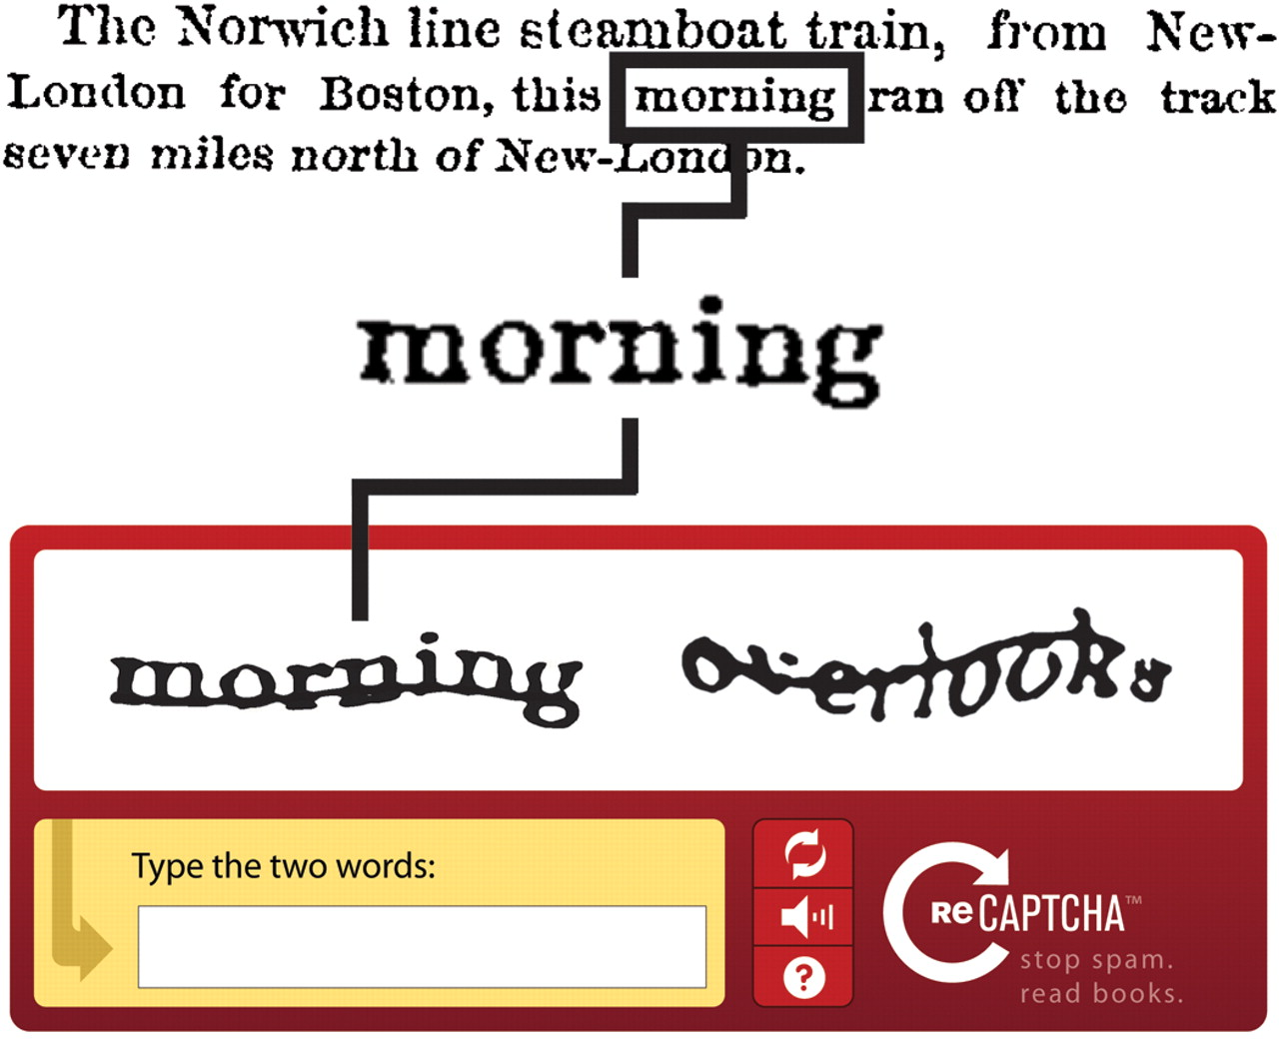
ReCAPTCHA (optical character recognition)

Slide 41
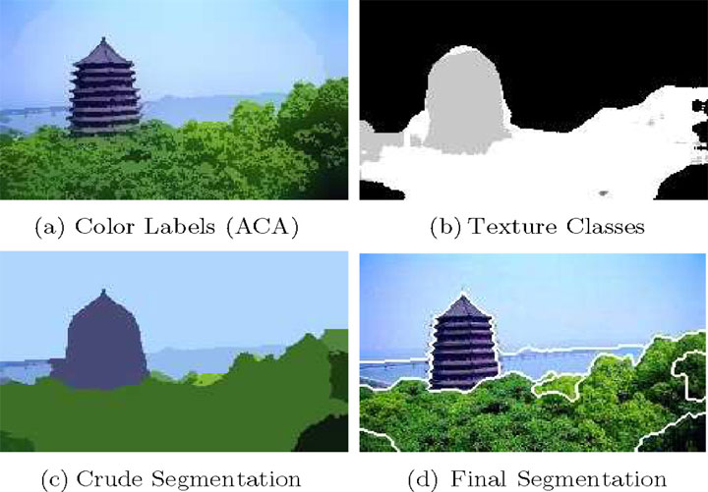
Image segmentation

Slide 42
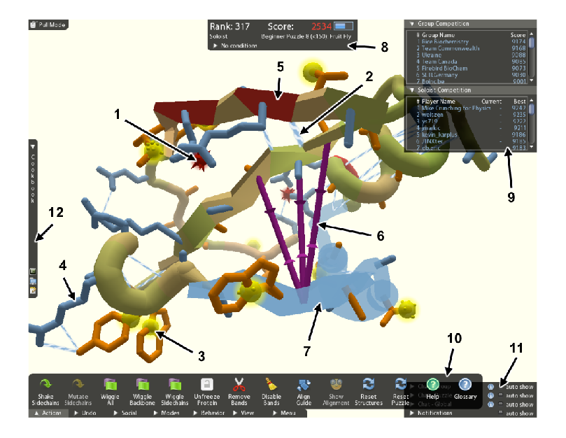
FoldIt (proteomics)
Notes:
3 Nature papers in under 2 years

Slide 43
FoldIt
Proteomics game at UW
Effectively created the genre of games that solve hard problems
Three Nature papers in under 2 years
Over 240,000 players, 200+ new per day

Slide 44
Abstraction and modularity in game design
Abstraction
Is the player doing the goal task directly?
An abstracted game:
No need for expertise in the problem domain
No obvious connection to the real-world value
Modularity
Each player solves part of the overall problem
The system combines the contributions of different players
Programs have natural modularity, created by the programmer
In Pipe Jam:
World = program
Level = class
Board = method

Slide 45
Comparison of games
Game | Abstraction? | Modularity?
Image labeling | ✗ | ✓
Translation | ✗ | ✓
OCR | ✗ | ✓
Image segmentation | ✗ | ✓
Protein folding | ✗ | ✗
Type inference | ✓ | ✓
Challenge: create more games that are abstract and modular

Slide 46
Pipe Jam solves multiple problems
Anything that can be expressed as a type system:
null pointer errors
encryption
SQL injection
unintended side effects
format string and regexp validation
incorrect equality checks
race conditions and deadlocks
units of measurement
For a new type system:
Map type system into the Pipe Jam schema
Convert a program to a game instance
Pipe Jam also contains a layout game (different skill set)

Slide 47
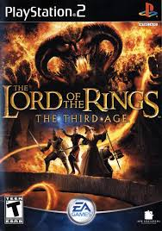
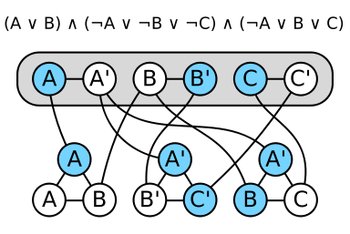
One game to rule them all
Problem reduction: Many problems can be converted to SAT
Can we gamify all those problems simultaneously?

Slide 48
Don’t think about SAT
… when you play the game
… when you design the game
Translation to SAT:
Explodes problem size
Destroys problem structure, no human intuition

Slide 49
Casual gamers vs. trained experts
With time, players develop unique skills
A plumber might be a protein-folding savant
Do casual games do useful work, or are they merely in training?
Notes:
Gaming is a gateway drug to SE

Slide 50
Creating test cases
Pit players against one another
Developers and testers are friendly adversaries
Given a solved game, seek a set of input balls that would cause a conflict

Slide 51
Other games being built
Invariant detection (a la Daikon)
Model checking
Model merging
Register allocation
… your ideas here!
* These are not my ideas; many come from DARPA’s Crowd-Sourced Formal Verification Program (Dr. Drew Dean, PM)

Slide 52
Status
Prototypes exists
Scales to small programs (thousands of lines)
Players say it is “kind of fun”
Many challenges remain
Scale to larger programs
Create tests (example failures, or counterexamples)
Scale to multiple players (parallelism, social aspects)
Make the game more fun

Slide 53
Credits
Collaborators on Verification Games project:
Francois Boucher-Genesse, Jonathan Burke, Matthew Burns, Seth Cooper, Craig Conner, Werner Dietl, Stephanie Dietzel, Nat Mote, Tim Pavlik, Zoran Popović, Tyler Rigsby, Eric Spishak, Brian Walker
Funding: DARPA

Slide 54

Gamification of SE (program verification)
Pipe Jam game…
encodes correctness condition
utilizes physical intuition & human insight
is playable by anyone
Goal: cheaper verification ⇒ more verification
http://cs.washington.edu/verigames
Limited beta coming on July 23; ask me for a passcode

Slide 55
Hard problems in software engineering
Choosing modularity and abstractions
Task breakdown
Dividing tasks between people and tools
Transparent vs. powerful tools
Optimizing intractable problems
Cooperation, competition, and specialization
What is the role of training?
Information overload
Making SE fun
Games↔SE: A useful, if imperfect, analogy
Science benefits from:
A games perspective on SE
A SE perspective on games
May apply elsewhere

